Slide 1
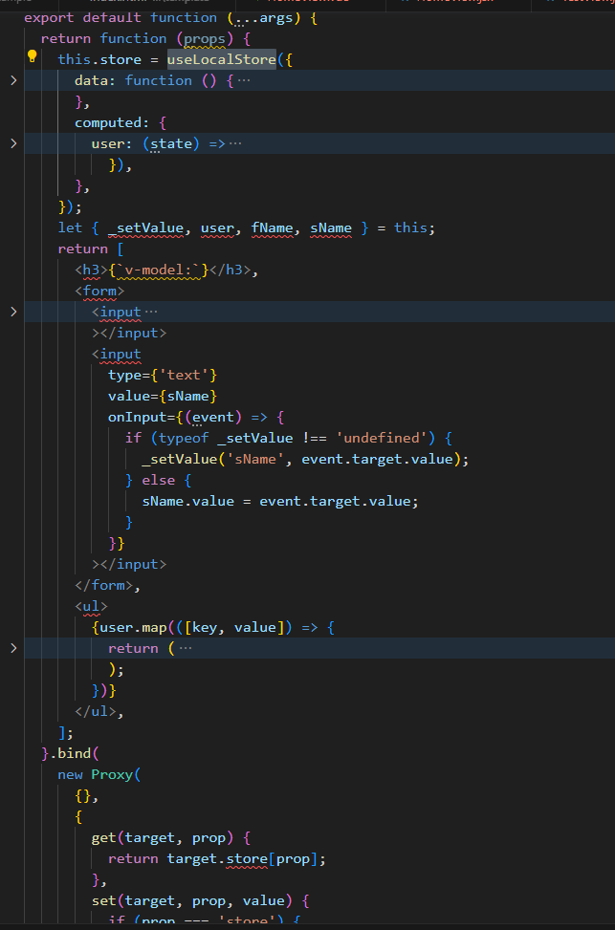
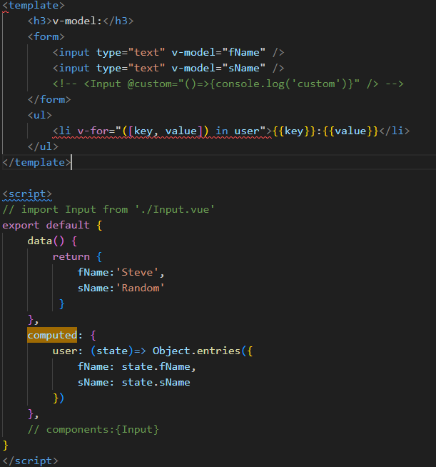
VUE
Horizon
一切都是模板，丰富的语法糖
一切都是函数，纯js解决一切问题
vue使用基于HTML的模板语法，将模板直接写在标记语言中，使用双大括号"{{}}"来绑定数据。
将组件视为一个完整的实体，拥有自己的模板、样式和逻辑
React使用JSX（JavaScript XML）语法，将组件结构和逻辑直接写在JavaScript中，允许在JavaScript中嵌入HTML。
加强调函数式组件的概念，组件是由函数定义的(纯js)
绑定 this
合并 class 和 style
创建 getter/setter
v-if / v-for / v-show 指令
computed / watch / methods
纯js都可以做

Slide 2

VUE应用切换到Horizon框架：支撑各产品快速、低工作量上车Horizon框架
现状：GTS及计算产品线现存vue2/3代码1000W+，如果切换Horizon工作量巨大，需要一个工具来牵引业务切换到horizon
目标：
提供Vue SFC转换工具，代码转换率 >70%
Polyfill.js 模拟vue独有API,以及router,pinia等能力库
组件库eview API适配 （待讨论规划）
实现：vue → AST语法树(vue) → 转换 → AST语法树(horizon) →horizon
工具转换（70%）
1. 将 Vue 组件中的选项和生命周期方法（如props、data、methods、created、mounted等）转换为相应的horizon选项和生命周期方法（如props、state、class components、function components、useEffect、useState等）
2.在 horizon 中使用与 Vue 相似的指令，例如：v-for可以转换为map()；v-if可以转换为 && 运算符，v-show可以转换为style 。需要注意判断条件的位置和语法结构。
3.将vue使用到的组件库代码和eview的组件转换API
VUE3业务代码
Vue生态--
组件库
Vue生态库--
router / pinia
Horizon转换工具
Jsx模板类型的组件转为horizon对应组件引用代码
纯API相关，horizon无相关替代或者完全不兼容的库，采取polyfill的方式兼容兼容
.vue文件转化为jsx
Horizon代码
（ 转化率>70% ）
Horizon 三方库
转化率>70%
Polyfill 补充
将vue中自有特殊的API模拟实现，
将特有常见的组件库(router,pinia)等模拟实现
适配开发
手工修改
Horizon应用包
Horizon-vue polyfill
提供切换指南，针对特殊场景进行手动调整 （30%）
自动转换工具不可能完美地将 Vue业务组件使用转换为eview，需要进行手动调整。确保代码逻辑正确和组件渲染成功。
Horizon-core
浏览器

Slide 3
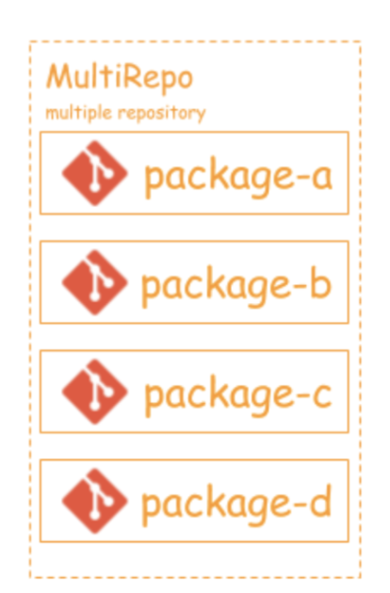
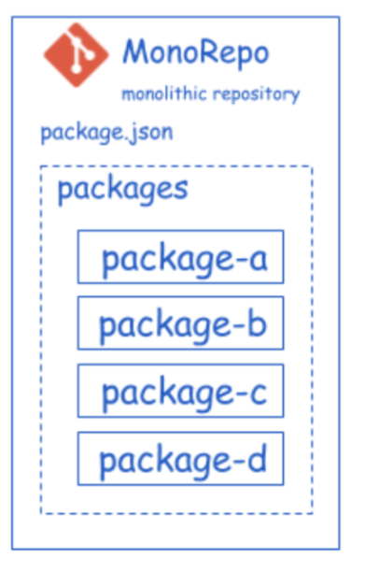
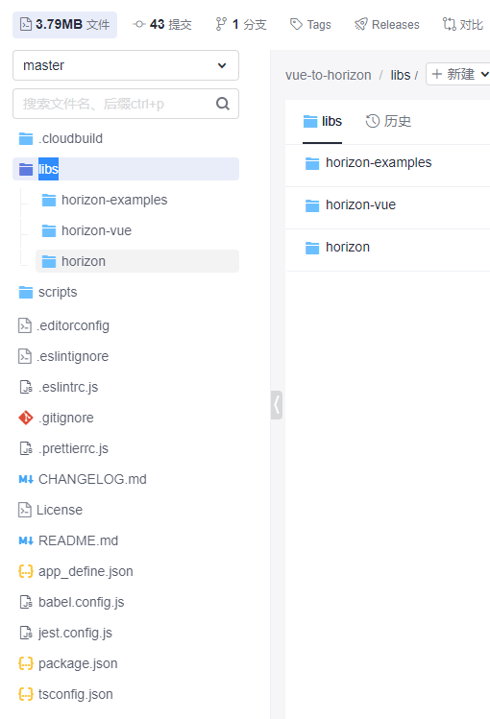
工具开发： 尝试monorepo代码仓架构
当前代码目录
vs
成倍减少编译时间
成倍提升开发效率
依赖包集中统一管理
PC，移动端代码管理更方便
一行命令即可部署多个服务
三方库管理
代码合入容易冲突？

Slide 4
验证场景
step1
vue3 → horizon
150 API vs 30 API
已完成
https://codehub-y.huawei.com/aWX605196/vue-to-horizon/files?ref=master&filePath=libs%2Fhorizon-examples%2Fvue-basic-example
step2
vue + router + pinia => horizon +routerAdapter +horizonX
已完成
https://codehub-y.huawei.com/aWX605196/vue-to-horizon/files?ref=master&filePath=libs%2Fhorizon-examples%2Fvue-chat-example
step3
vue3 + element Plus + router + pinia → horizon + element plus + routerAdapter +horizonX
开发中
https://codehub-y.huawei.com/aWX605196/vue-to-horizon/files?ref=master&filePath=libs%2Fhorizon-examples%2Felement-plus-vue-example
step4
vue3 + element Plus + router + pinia → horizon + eview

Slide 5
Vue2Horizon Conversion tool

Slide 6
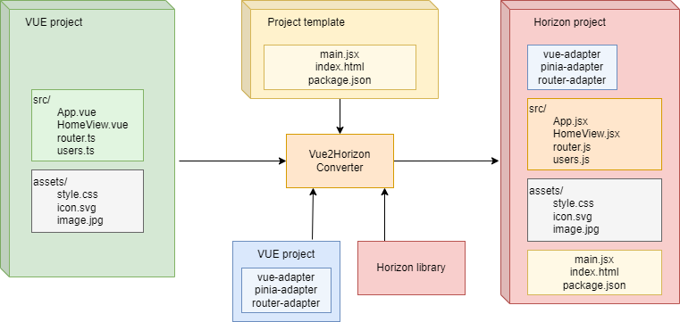
High-Level Conversion Architecture
架构概览
Final Horizon project consists of the project template, adapters and compiled version of Horizon. This all together creates standalone Horizon application
Vue Components are processed and Horizon JSX components are generated
Typescript and JavaScript files are also processed, all VUE-based imports are redirected to adapters and API conversion is applied
All other files are directly copied to destination directory.
生成模板文件,适配API文件, horizon运行态
组件转换
将VUE API 转换为horizon API或者适配
纯js文件直接复用

Slide 7
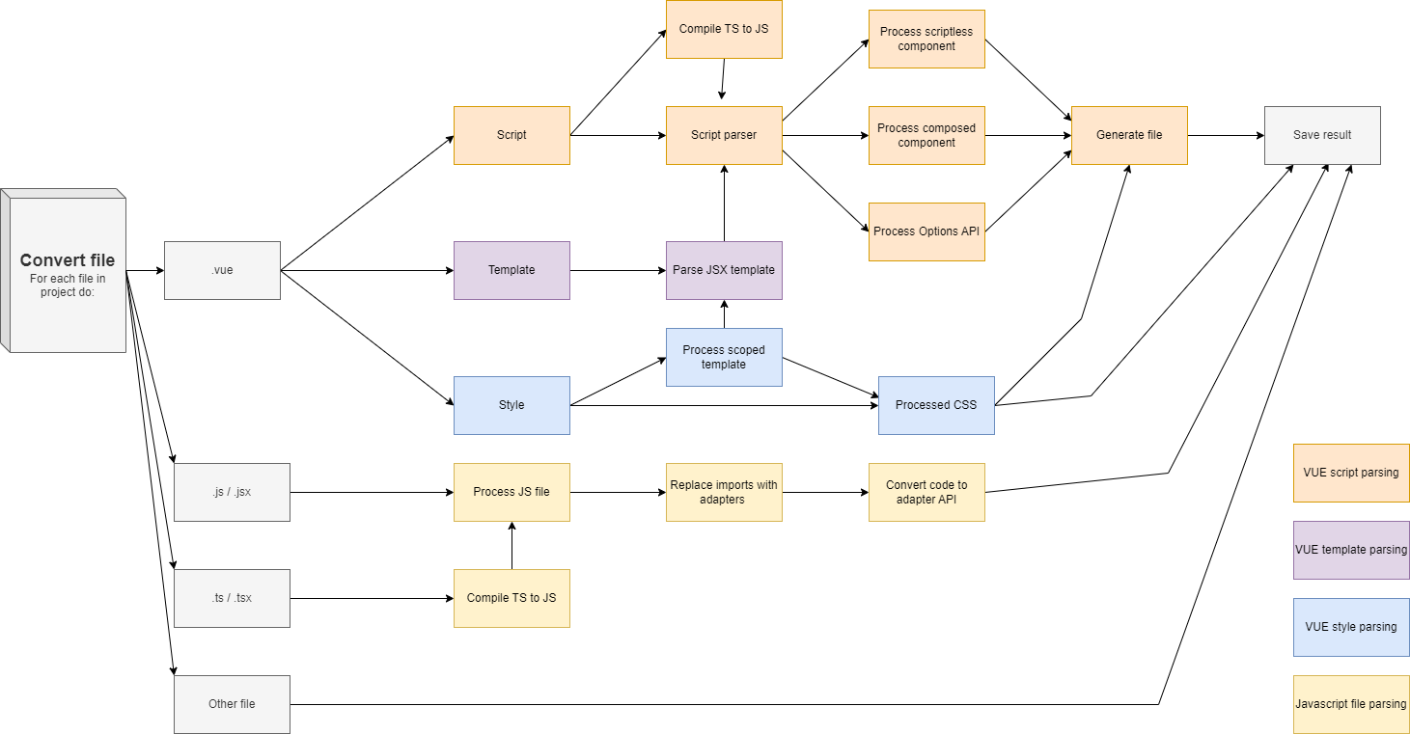
Detailed Conversion diagram
Script is parsed using Esprima and Escodegen libraries. Resolves imports, applies adapters, resolves reactive variables, creates internal store for options API and overrides directives in template.
整体实现
VUE file is divided into three parts, that are processed separately.
Styles are converted to JSX element, scope hash is added.
Final component is then generated as composite function component, that contains processed script code and returns JSX template with attached script element in single file.
Vue组成
Styles are converted to JSX element
and scope hash is added.
Router APIs and Pinia stores APIs are detected and processed.
Pinia is converted to HorizonX via adapter,
Router is processed using own adapter implementation.
Vue三方库 适配

Slide 8
Functionality we added to Horizon
Horizon附加能力
Component registration – component can be registered in Horizon and used as simple tag without import
Vue like classes and styles – setting styles as array, object of classes to display or hide
Component tag – “component” component takes “:is” attribute that allows dynamically set what component class it should be
Slotted components - component uses <slot> components to specify, where <template> tags from its children should be placed
Class propagation – allows propagation of CSS scope
CSS variables – CSS variables can be now used in Horizon
Reactive proxies (ref, computed - can be converted to new useSignal React hook)
Component state with use of local store
Vue全局组件注册能力
Vue样式组件/元素
插动态组件标签（Dynamic Component Tag）是一种用于在模板中动态确定组件标签的技术。
插槽 组件嵌套
Css 作用域
响应式API
组件状态本地存储

Slide 9
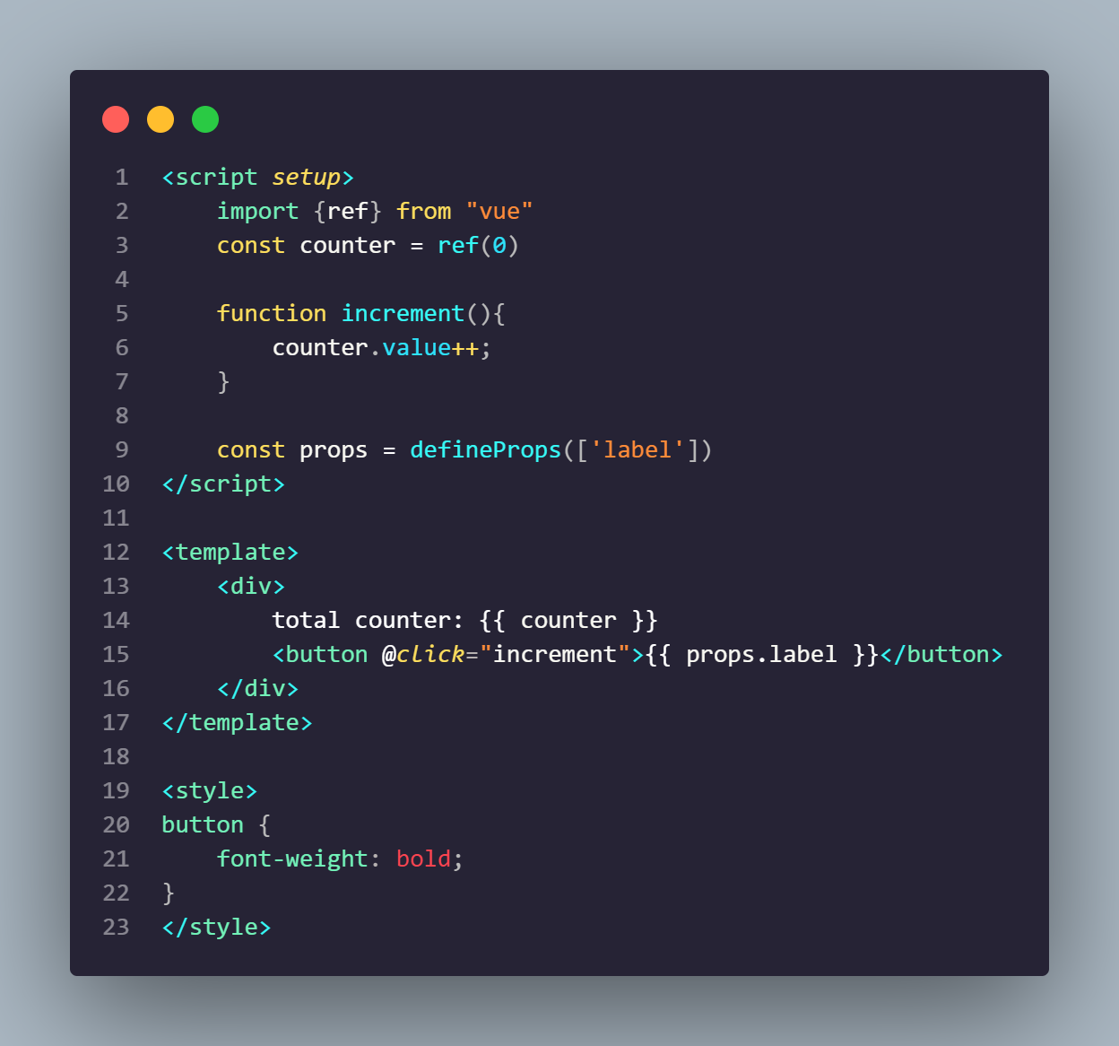
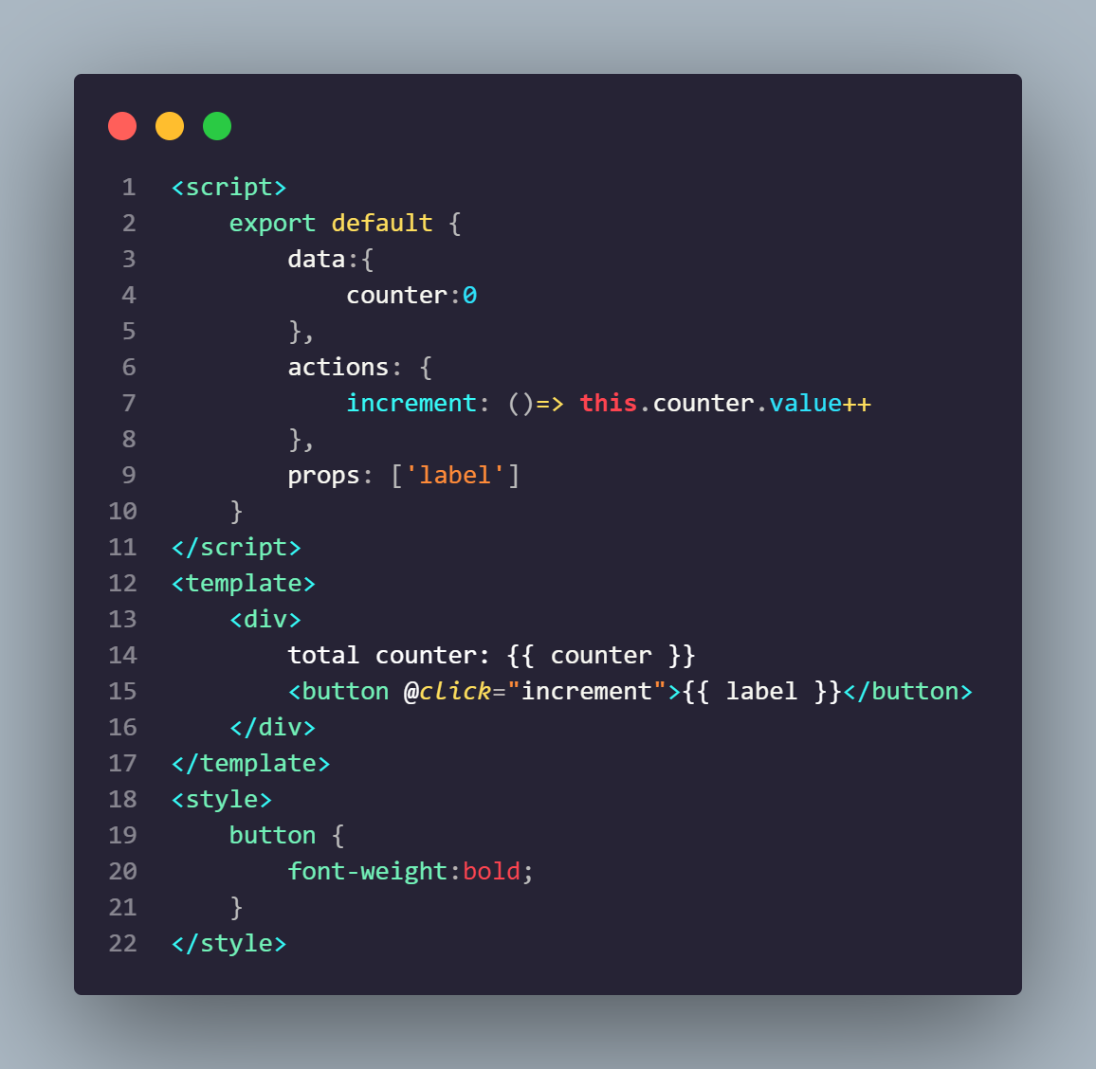
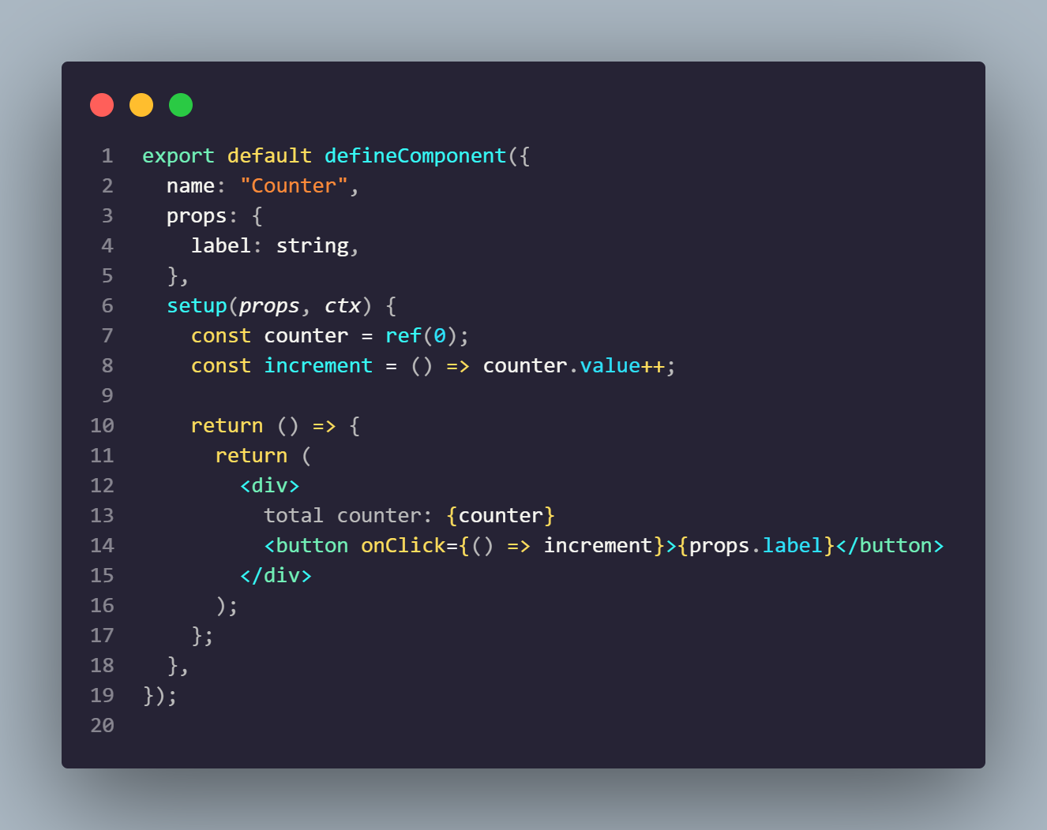
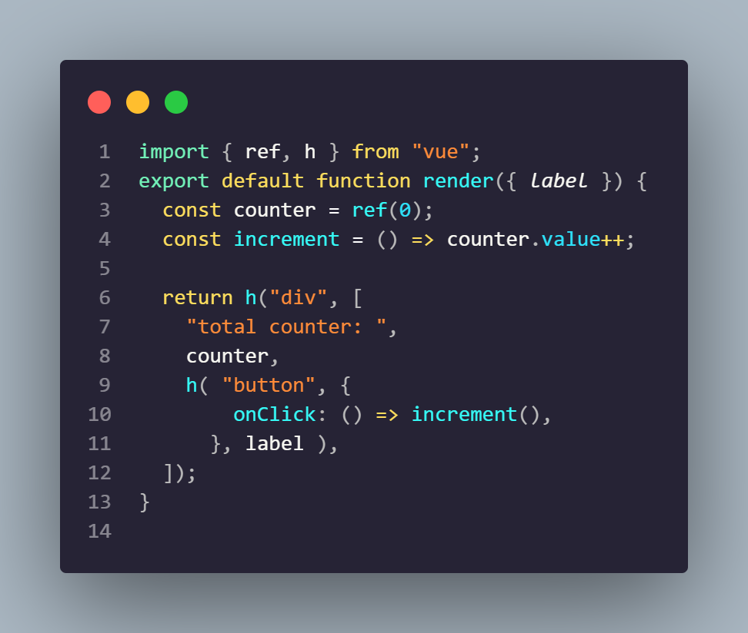
Vue Compatibility Considerations
Vue关键能力
Single file component (.vue format) –component is split into three sections, template, script and style. There are 2 styles to define components in .vue format. Compositing and Options API
Options API 是Vue.js 的一种编程模式，用于编写中小组件的选项，提供了一种基于对象的方式来定义组件的选项
CompositionAPI.vue
Options API
OptionsAPI.vue
Composition API:
Composition API 基于函数，通过使用一组逻辑相关的函数来定义组件的行为
Components using options API are implemented using local horizon store, that holds component state, actions and getters
We are using reactive proxies as state variables. They can be later used in JSX template, where we need to resolve their value if necessary.
Programmatic component definition(.js or .jsx format) – Component with their render function are defined directly in code using h() or defineComponent() API calls. Vue compiler is used to convert .vue files to this format.
JSX Component Definition
FunctionComponent.jsx
Hyperscript API
Hyperscript.js
API for defining components programmatically. Offers greater flexibility but more difficult to convert
Low level access to define Vue component rendering with h() function

Slide 10
Vue2Horizon conversion challenges
挑战
Templates use non-standard attributes that cannot be parsed by usual JSX parser (Boolean attributes, directives, VUE-events, bindings…): We used regex pre-processing and custom JSX parser, that allowed us to use special syntax.
Horizon does not use directives: Directives are processed in conversion-time and completely converted to horizon compatible code.
VUE has very benevolent coding style: Conversion tool allows using them and mix-and-match different styles, automatically implements missing imports and fixes use of ref variables in JSX code by using their value instead.
Conversion of additional Javascript files is very confusing: We implemented conversion layer to process additional JS/TS files and use correct imports and adapters. We also implemented larger adapters for Pinia and Routers that now work in Horizon without need to reimplement them manually
Options API and Composition API: VUE uses multiple approaches to define components and stores. We implemented both options and composition API that can be used and mixed between components.
JSX解析器解析差异
Horizon不支持指令集
Vue支持/兼容 各种语法糖
Js,ts文件转换难度比较大
Vue支持选项API和组合两种组件编程模式

Slide 11
Conversion Verification
Step1: Vue -> Horizon
已完成
Basic demo
Basic demo is simple Hello world application that displays basic functionality, like local stores. It displays three views using dynamically loaded components and router. This template was provided to us to specify functionalities that should be implemented first. Third view was added as simple test of directive conversions and contains small examples of converted directives.
Step2: Vue + Pinia + Router -> Horizon + HorizonX +RouterAdapter
已完成
Chat demo
This demo is more consistent and complex test of convertor. This chat application was first implemented as new VUE application with more natural way of coding and then it was converted to Horizon using conversion tool. It implements router, Pinia store, local stores, reactive components, events and directives, both normal and scoped styles, code splitting and dynamic loading
Step3: Vue + Pinia + Router + ElementPlus -> Horizon + HorizonX +RouterAdapter + converted ElementPlus
进行中
ElementPlus demo
…

Slide 12
Element+ Vue components to Horizon conversion analysis
组件转换的挑战难度很大
Motivation: Test our conversion tool to perform conversion of 3rd party Vue components to Horizon
Goal: Convert 2 complex components (DatePicker and Table) to Horizon using Vue2Horizon tool
目标：挑选两个最复杂的组件尝试转换
Challenges:
Even simplest components (Button, Checkbox) have many internal dependencies
Complex components use many other simple components
Custom CSS handling instead of standard VUE way
Heavy use of custom directives and custom hooks across all components
Element+ library size:
Languages:
Typescript: 119 188 SLOC (1320 files)
VUE: 52 907 SLOC (775 files)
CSS: 17 606 SLOC (266 files)
依赖众多基础组件
CSS体系设计不一样
自定义指令很多
Conclusion :
Implementation of Element+ cannot be automatically converted to Horizon and requires manual bridging of its parts
Our conversion tool focused on converting .vue files to Horizon, but only 30% of Element+ code is using .vue file format
The architecture of Element+ components imports many shared TS files with heavy use of Vue API
TS code directly uses Vue APIs that are normally internally by the .vue file compiler, which regular apps don’t use.
Element+ uses custom CSS system that bypasses the regular .vue format using a custom namespace hook.

Slide 13

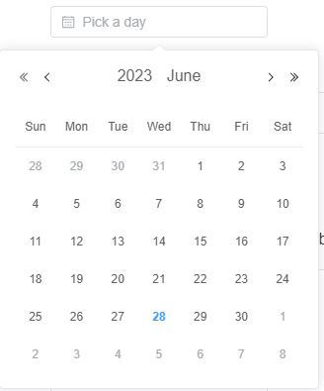
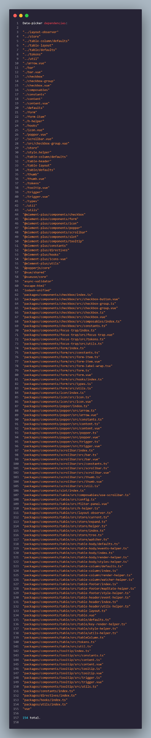
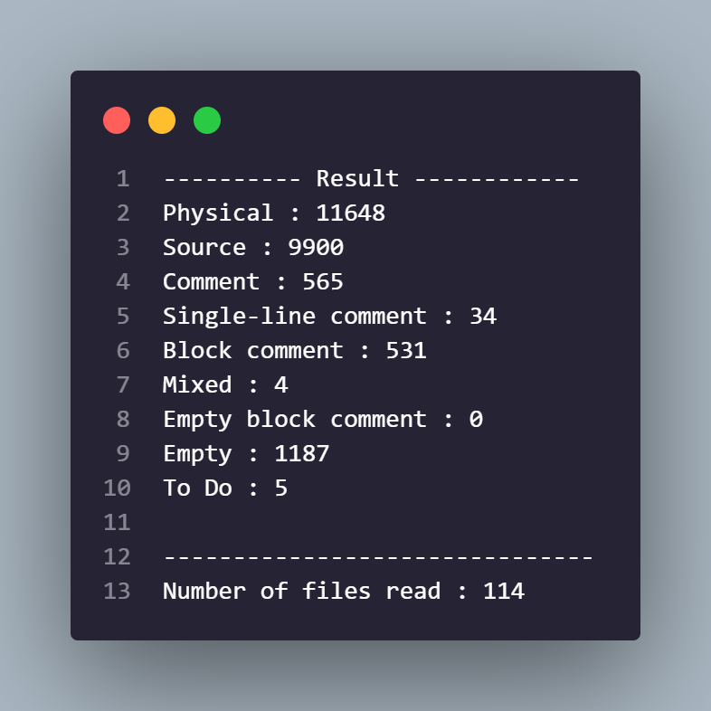
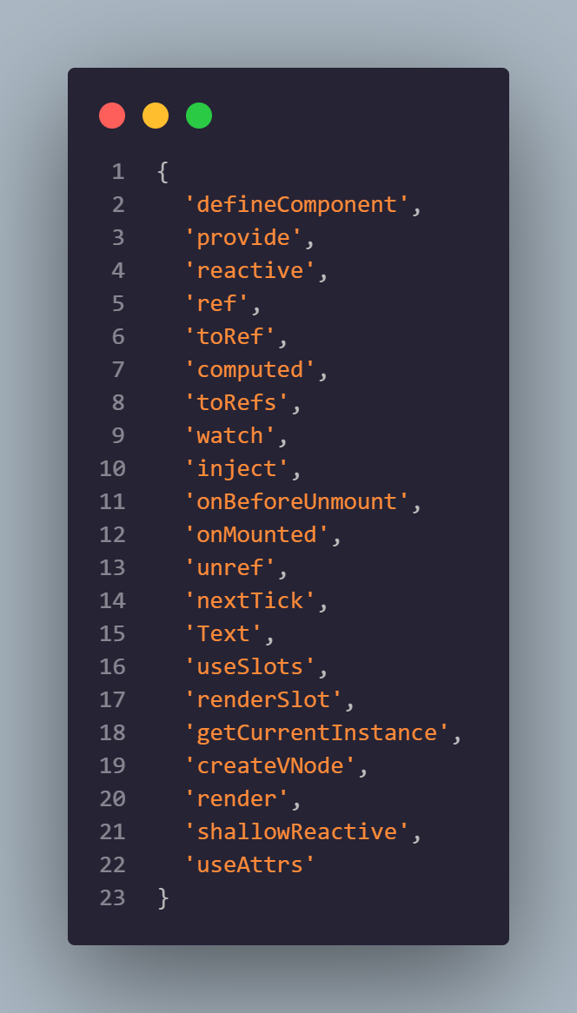
DatePicker Dependency analysis
https://github.com/element-plus/element-plus/blob/8b1dfa48f5c5713c5ad26ef046b9392d6fafb9fb/packages/components/table/src/h-helper.ts#L4
DatePicker internally uses 10 other Element+ Components ( Checkbox, Form, Icon, Popper, Scrollbar, Slot, Tooltip, Table, Focus-trap, TimePicker)
Together around 10k LoC to convert
But out of 154 import files only 21 is .vue files
Using tools like h-helper that makes auto-conversion not possible

Slide 14
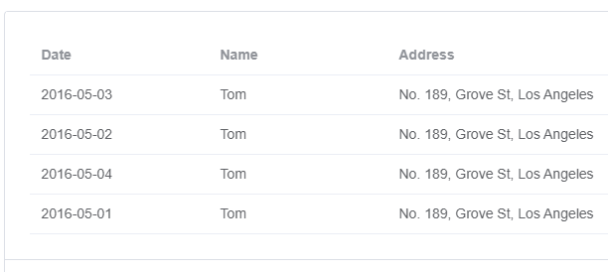
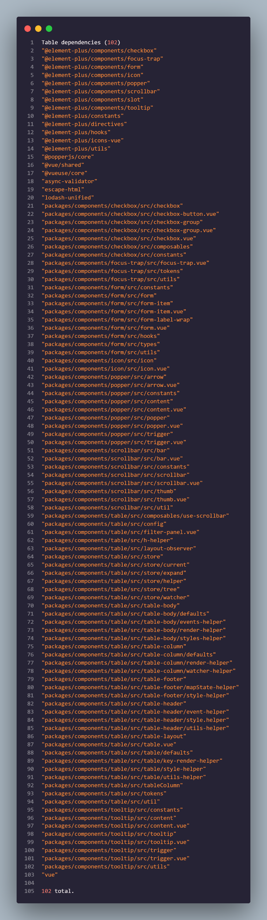
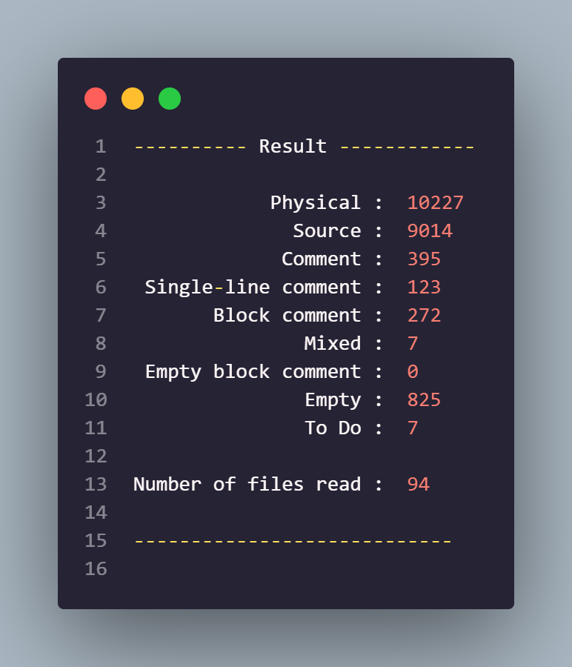
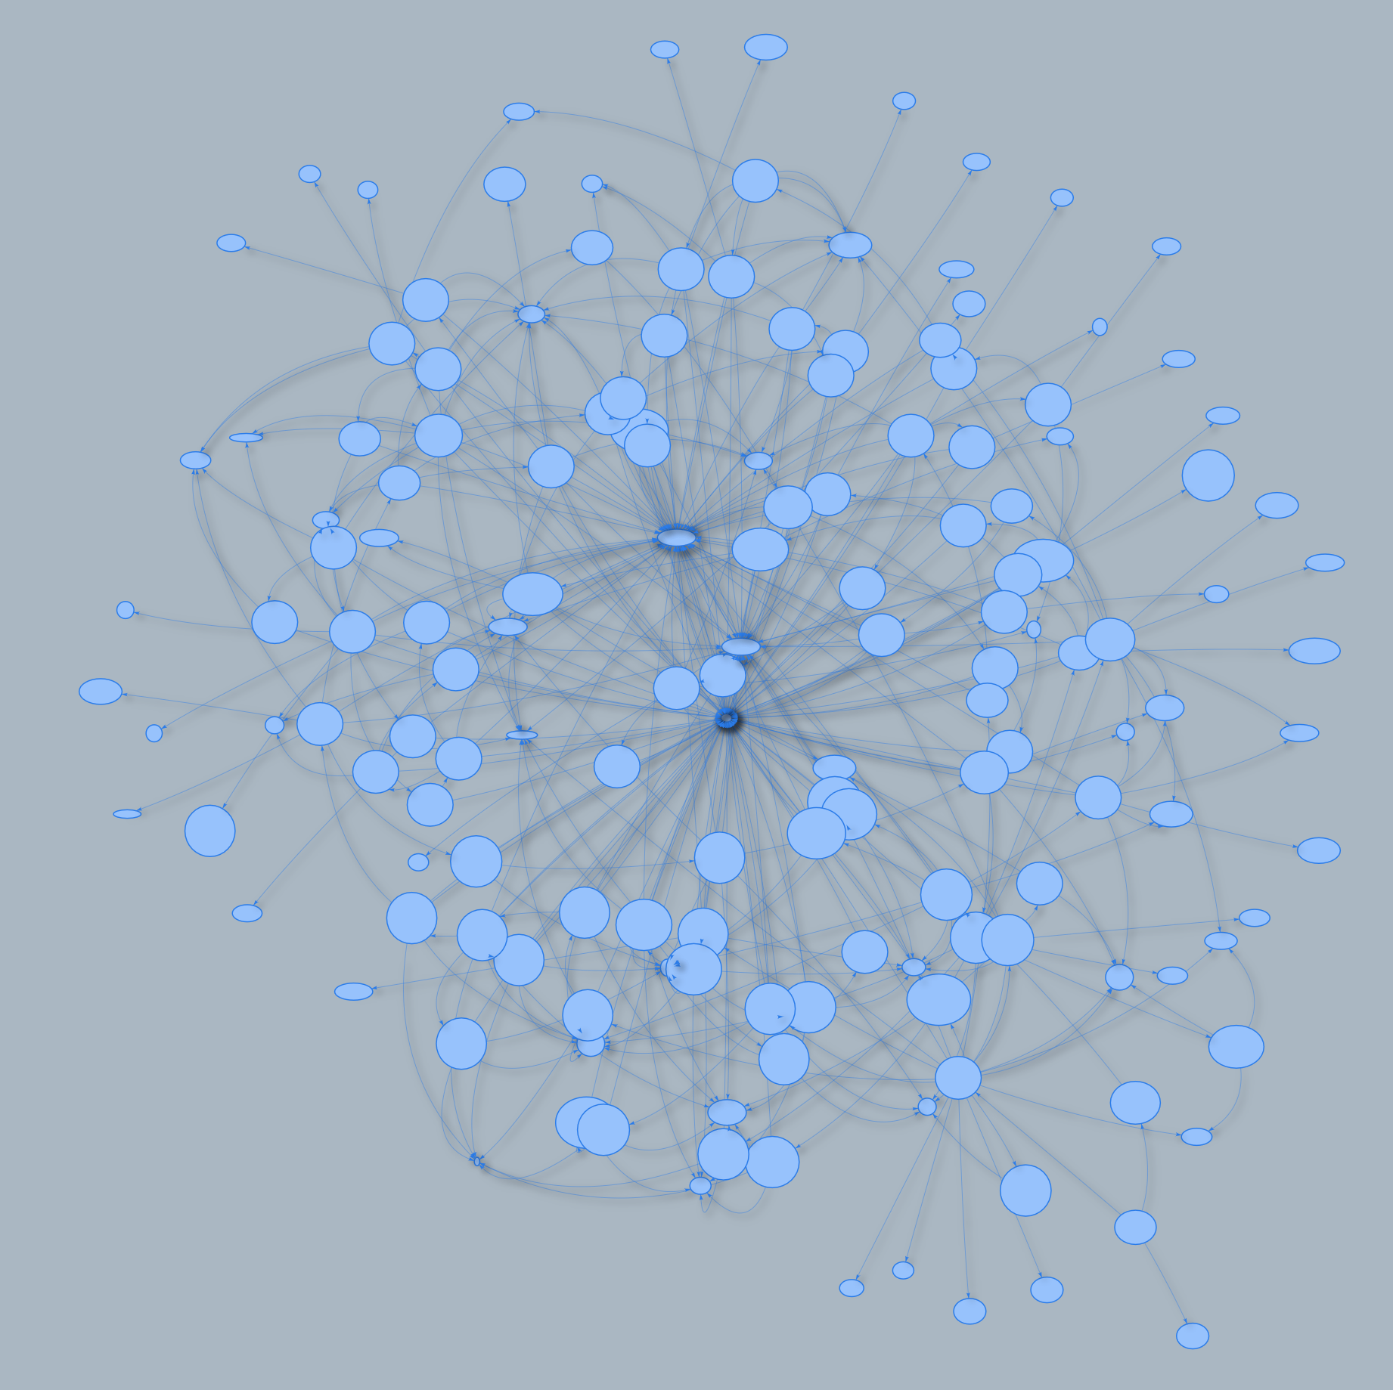
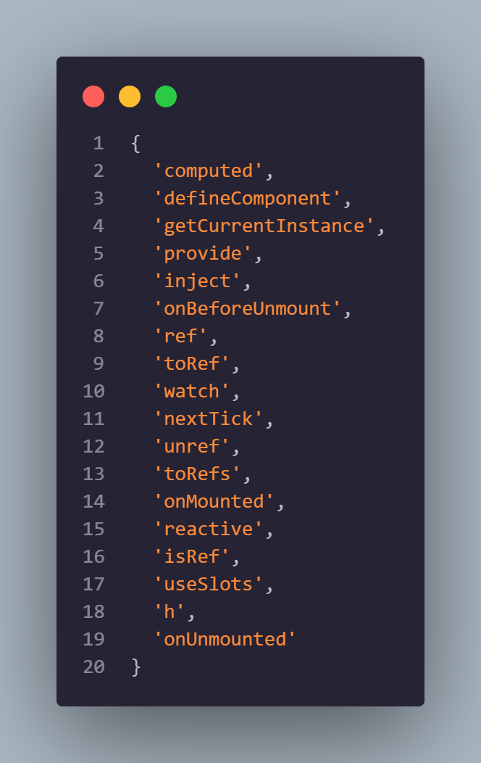
Table dependency analysis
Table internally uses 8 other Element+ Components ( Checkbox, Form, Icon, Popper, Scrollbar, Slot, Tooltip, Focus-trap)
Together around 9k LoC to convert
But out of 102 import files only 19 is .vue files
Using h-helper that makes auto-conversion not possible

Slide 15
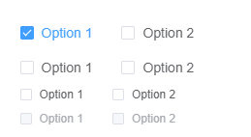
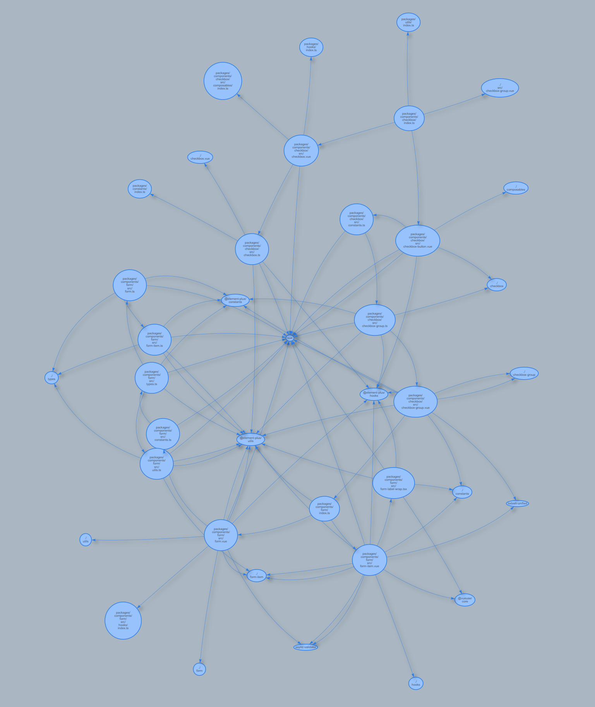
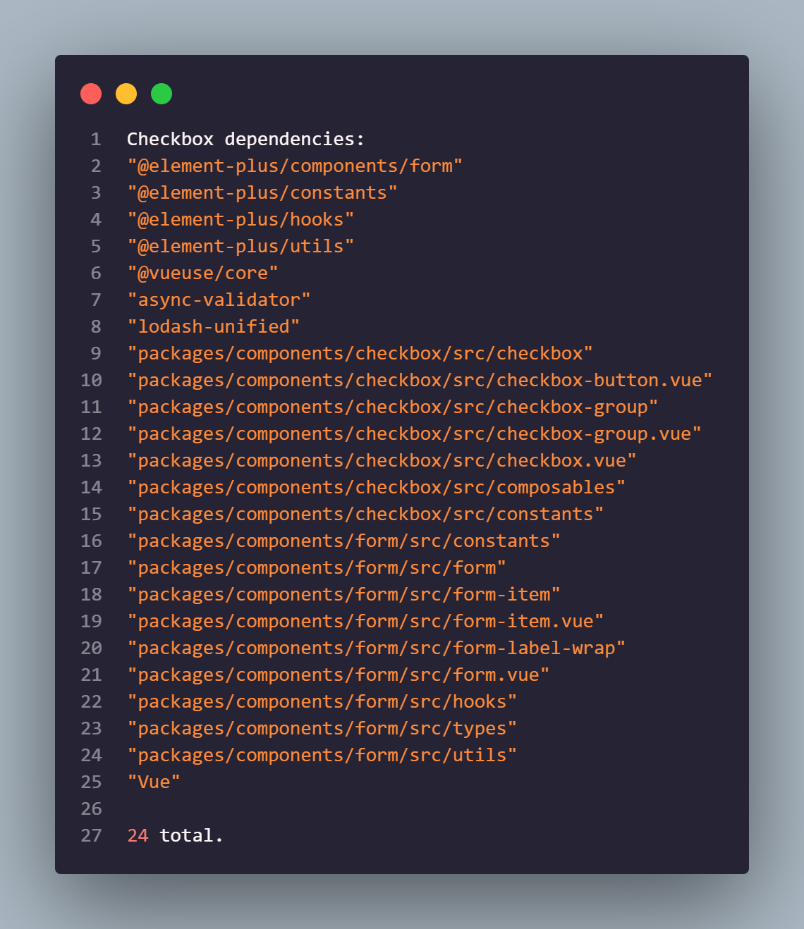

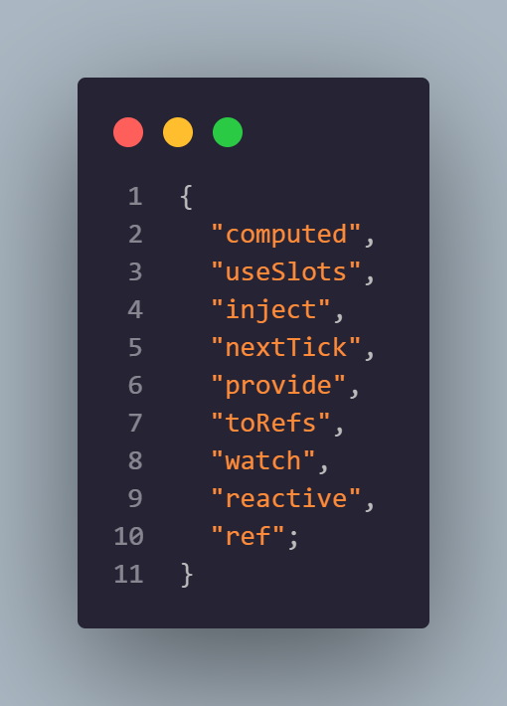
Checkbox Dependency analysis
Using utilities from Form component
Around 1.3k LoC to convert
Out of 24 import files only 5 is .vue files
With implementing few adapters we managed to convert this component together with Icon and Scrollbar

Slide 16
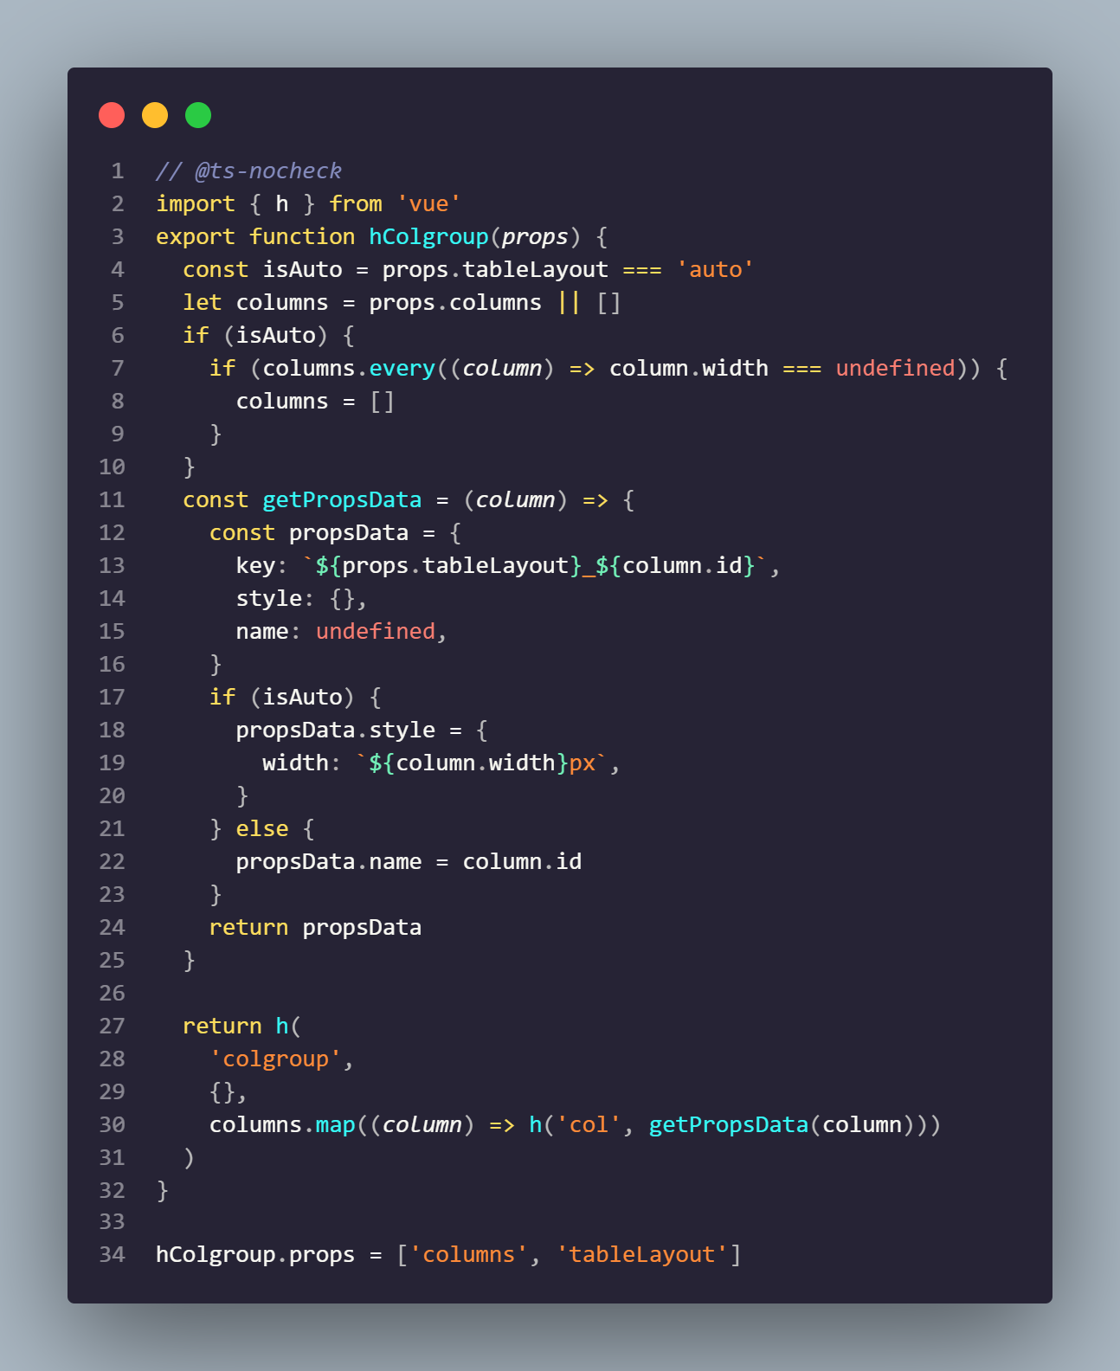
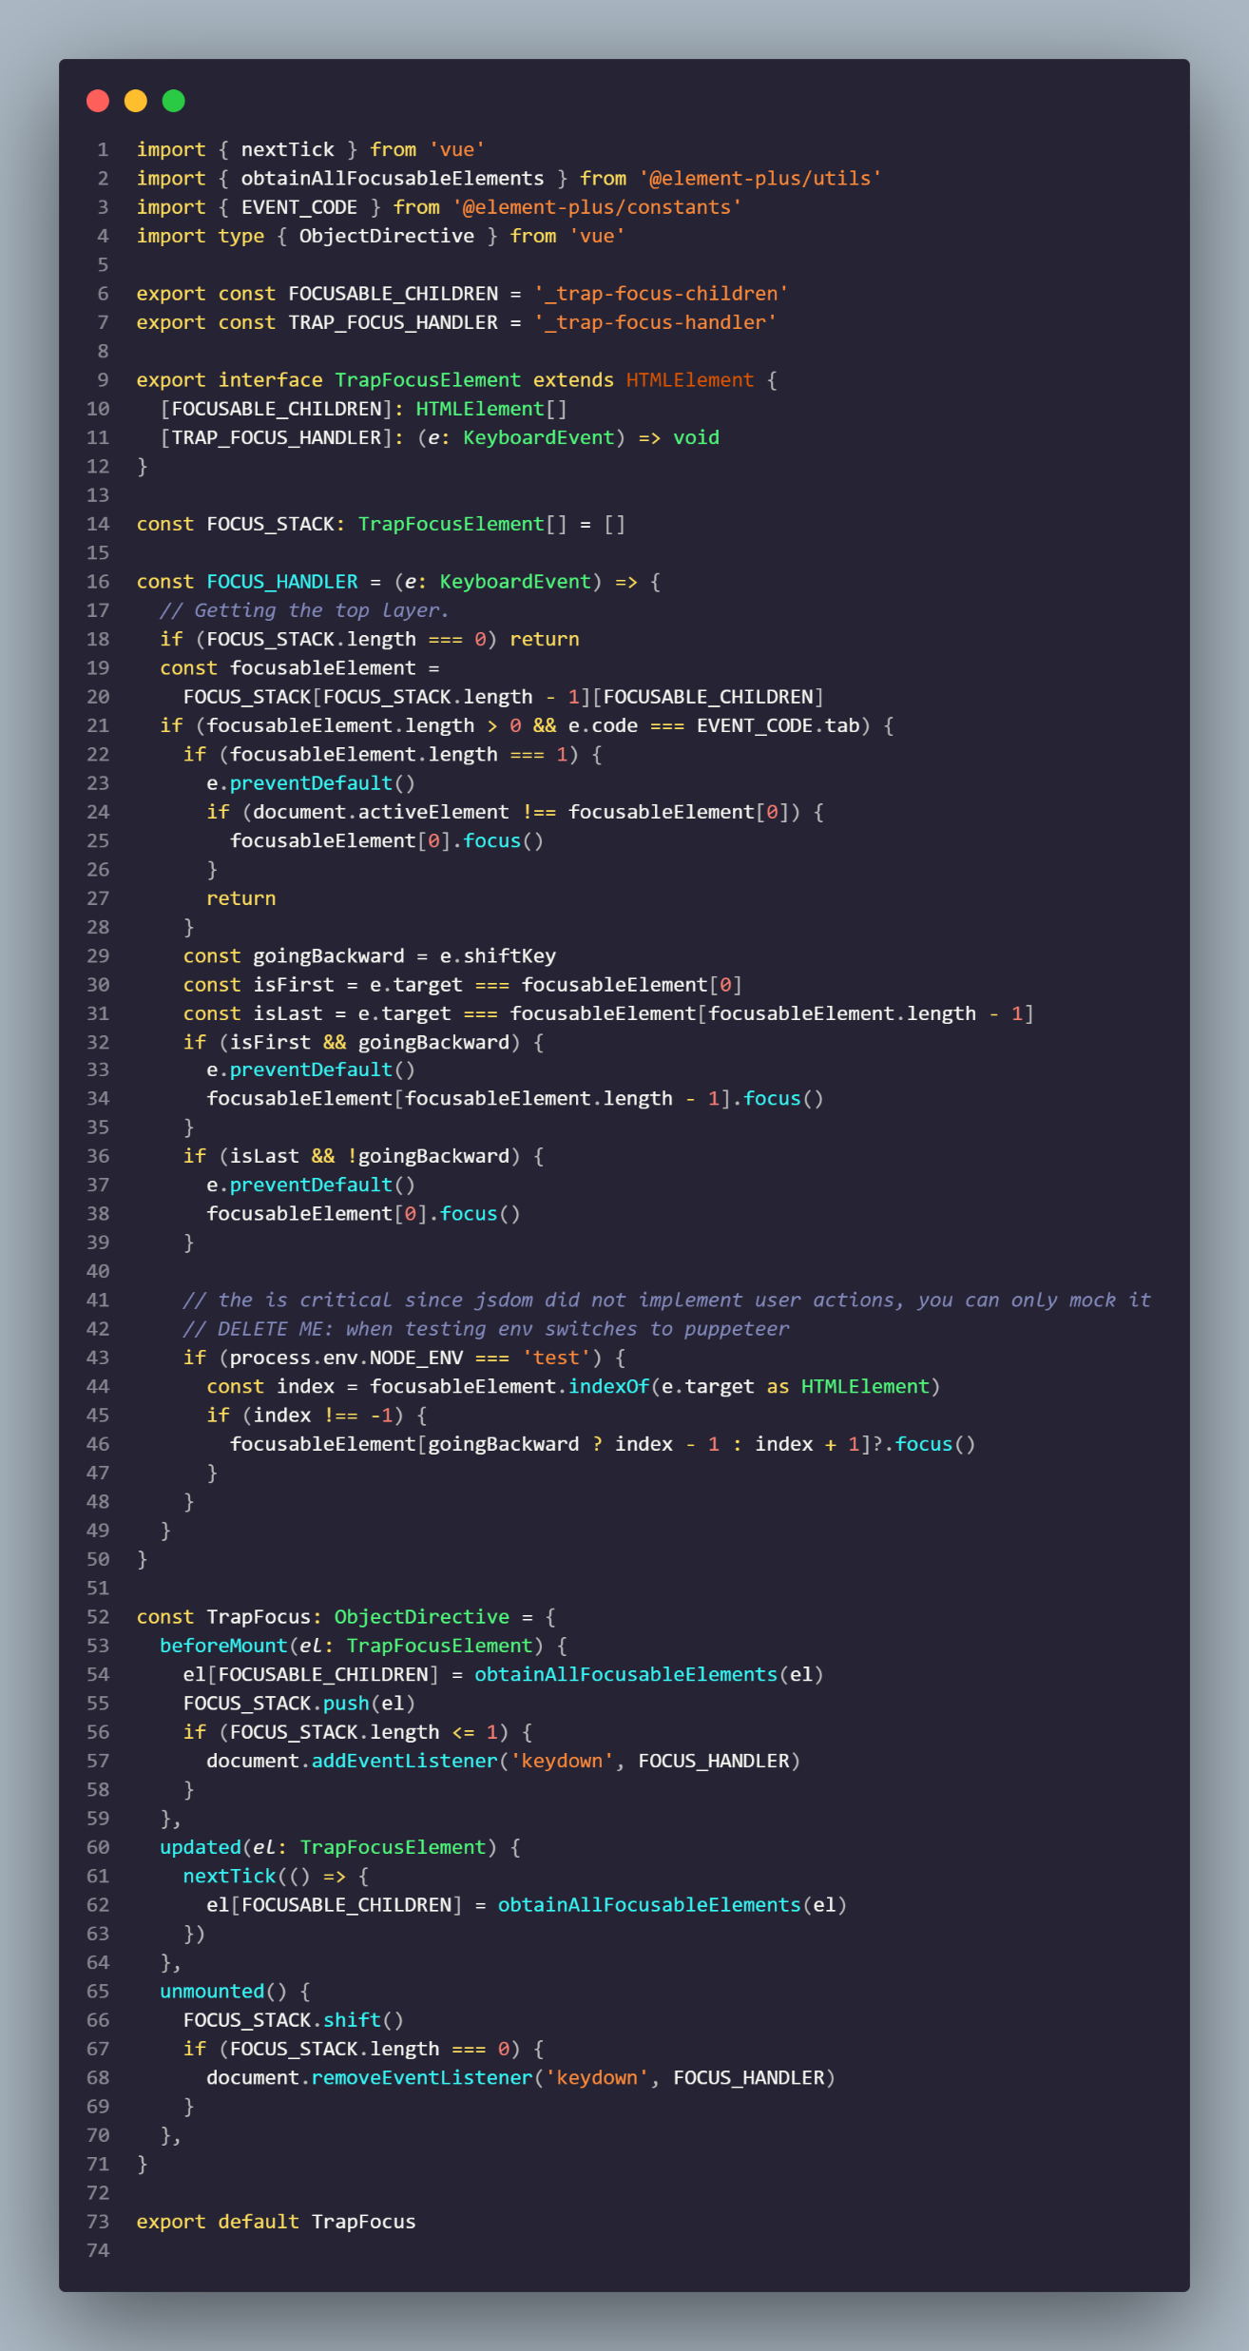
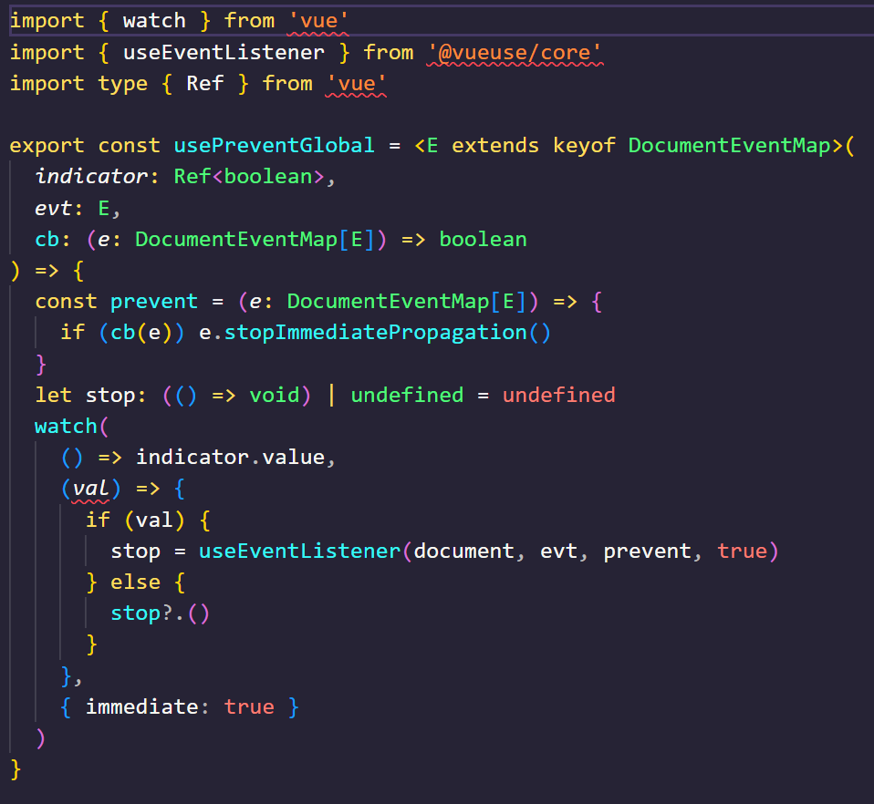
Examples Element+ utils that complicate automatic conversion
不同的事件机制
usePreventGlobal: Element+ uses different event system than Horizon and more complex manipulation with them must be handled manually
替换h函数到createELement
直接操作dom
h-helper: complex components like table use h function directly. This function is alternative of Horizon’s createElement and it is very difficult to implement automated conversion of this Vue API to Horizon
FocusTrap: Element+ uses direct logic over DOM, that we are unable to process with automatic convertor, specialized to convert Vue templates to JSX

Slide 17
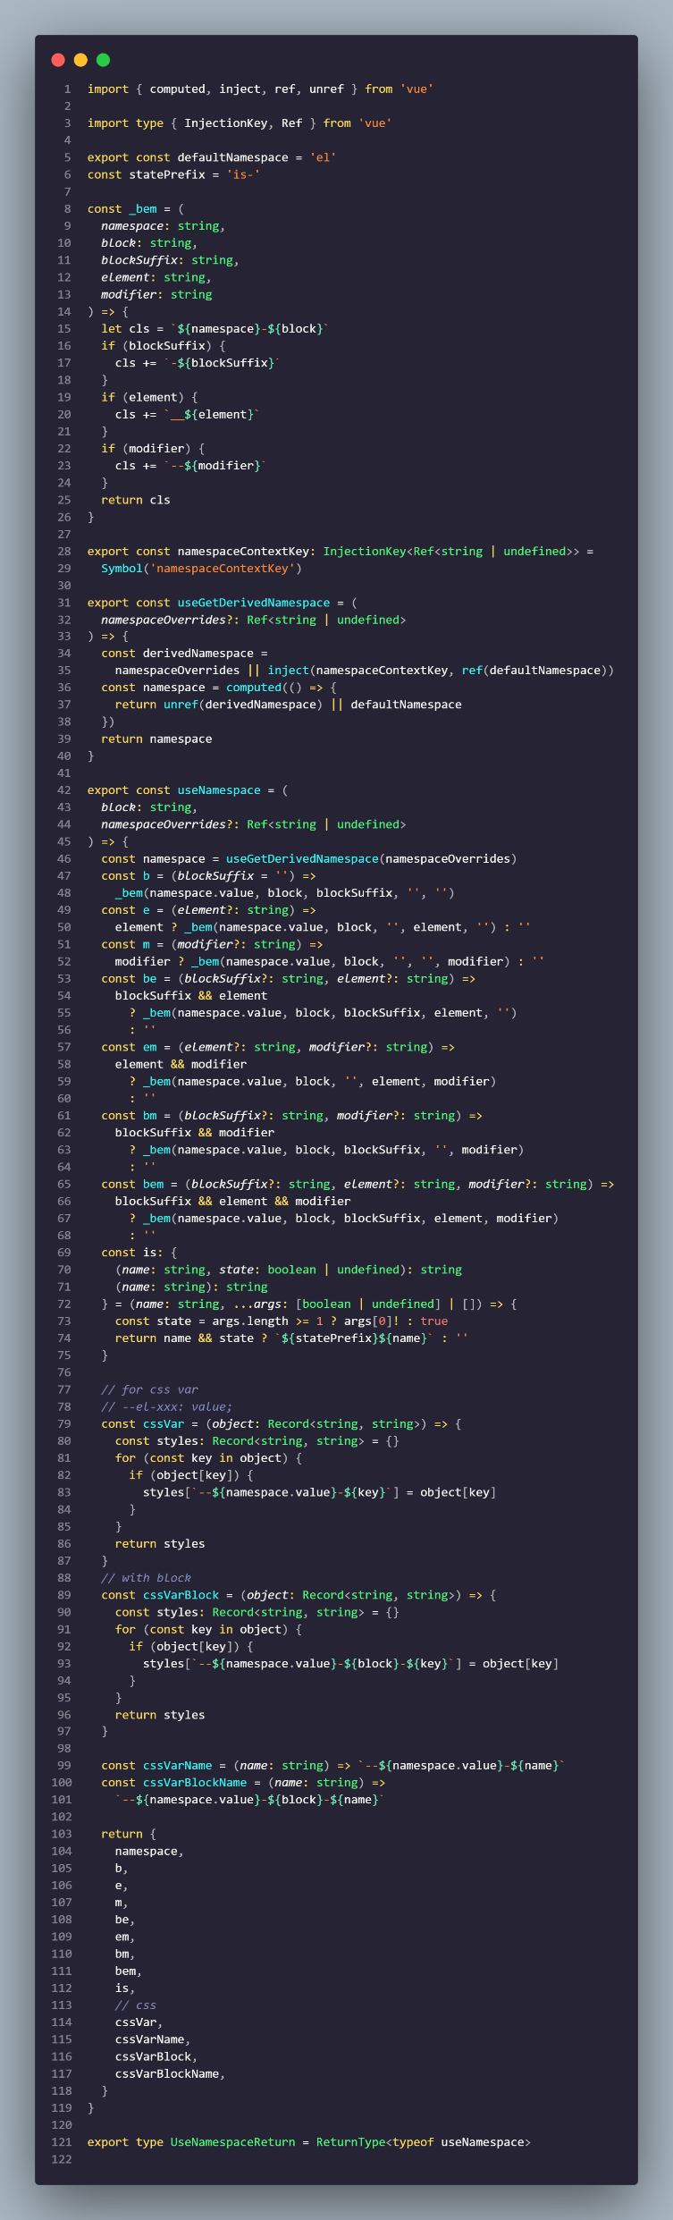
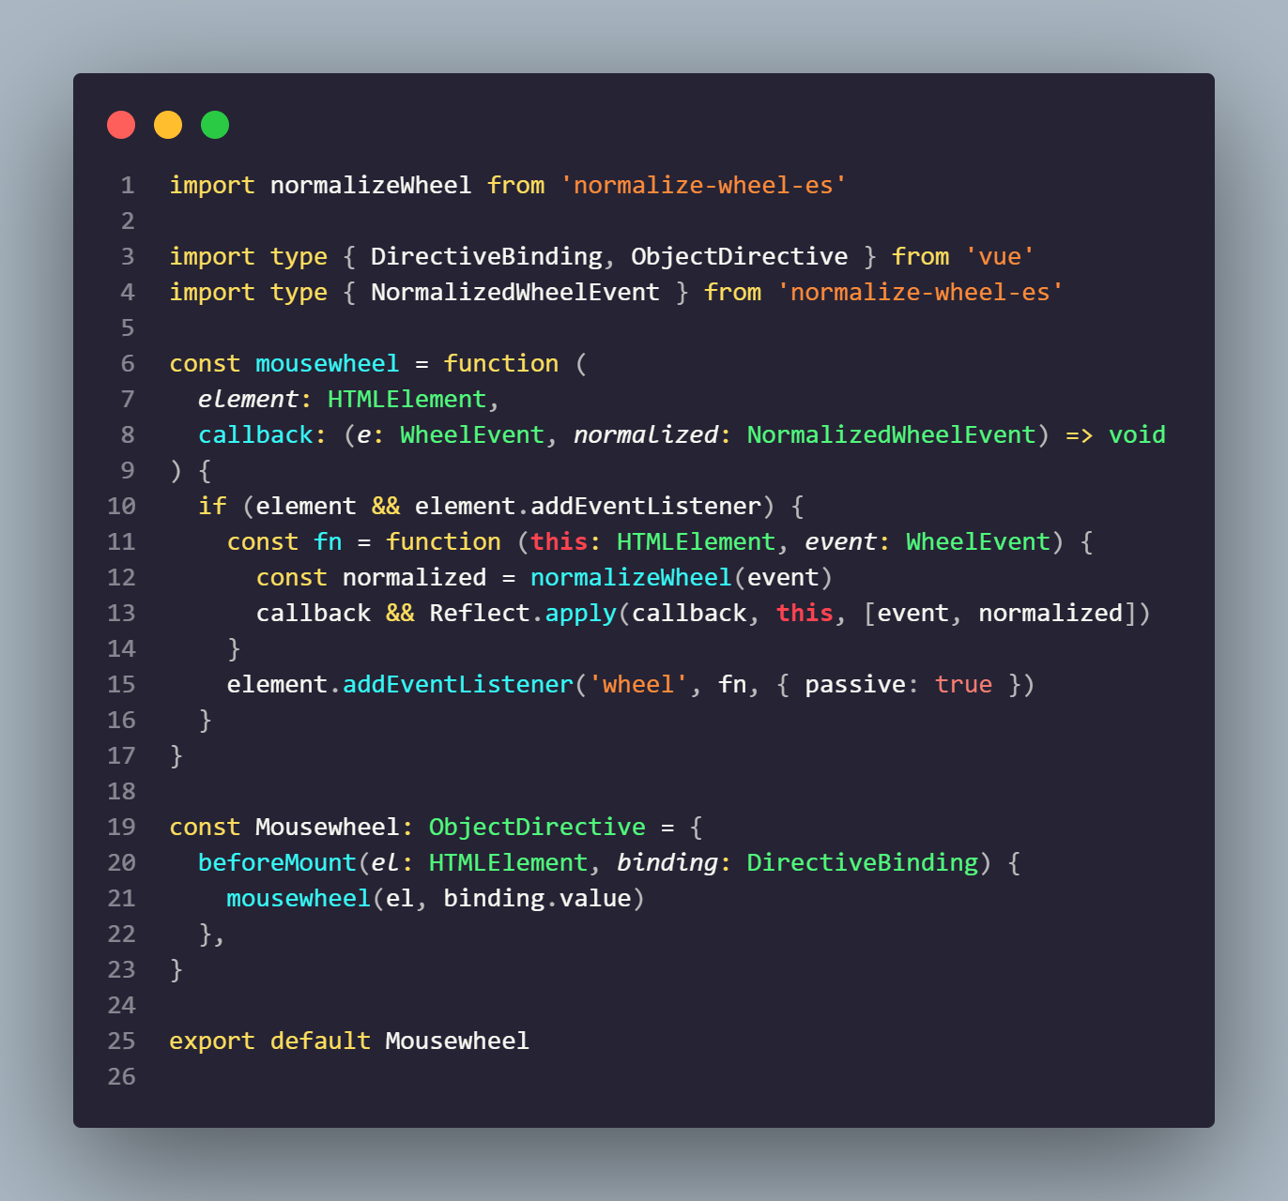
useNamespace: custom hook creates complex framework that crates CSS classnames. This way element plus bypasses usual styling system of Vue.
This custom hook is used in every single component.
自定义指令
自定义css体系
MouseWheel: element plus creates lots of custom directives, that enhance the system. Horizon does not use directives at all and we convert standard directives directly in jsx

Slide 18
AS IS
转换一
转换二
Vue工程
本地工程
浏览器
.vue / Ts/js / css / img
vue2Horizon
Compiler
.jsx / js / css / img / …
Horizon
Compiler
APP
Html Js css img
APP
Vue切换工具承载太多vue语法糖的转换。
功能复杂,场景容易遗漏
router
手动调整
Router Adpter
Manually
Horizon-core -runtime
pinia
horizonX
Element plus
响应式api
合并 class 和 style
创建 getter/setter
v-if / v-for / v-show 指令
computed ，option模式
watch / methods
Eview Adapter
Eview UI
vue
horizon
生成的jsx文件,和jsx风格不统一，可读性不好
比如组件上下文的强制补充、没有继承ts类型
TOBE
转换一
转换二
Vue工程
本地工程
浏览器
.vue / Ts/js / css / img
vue2Horizon
Compiler
.horizon / js / css / img / …
Horizon
Compiler
APP
Html Js css img
APP
1，将一部分vue的能力集成到horizon中，减少vue源码切换到horizon的工作量
2，生成.horizon文件替代jsx。一个新的中间态来支撑后续vue切换, Horizon自身特性。
3. 保持原有的类型提示和提升转换后代码的可读性
Horizon提供一部分匹配vue的能力
router
手动调整
Router Adpter
Manually
Horizon-core -runtime
pinia
horizonX
响应式api
合并 class 和 style
创建 getter/setter
v-if / v-for / v-show 指令
…
Element plus
Eview Adapter
Eview UI
vue
horizon

Slide 19
计划：
以产品实际工程为验证模板，继续验证eview proxy的能力
1, 定义一个.hr(hoirzon)格式，支持ts，支持一部分vue语法糖 2, 在horizon引擎中支持.hin格式的编译和runtime 3, 支持从 .vue 一次性转化为 .hr，以后均工作在 .hr 上
4, one-shot transpiler

Slide 20
browser
.Css
.vue
.ts
.js
App
html
JS
css
+
Compile/trans
Vue-Runtim.js
Compile/trans
elementUI
Horizon+adpter
.Css
.vue
.ts
.js

